Slide 1

Eligibility API – Log Insertion on client server
370707_ EDI _Draft V1.0
Documented by |  | [Sohaib Qamar (Business Analyst)]
Sr. # | Reviewer Name | Team Name | Date
1 | Ahmed Afzal | Business Analyst
2 | Faisal Mahmood | Manager (EDI)
3 | Muhammad Noman | Software Engineer
4

Slide 2
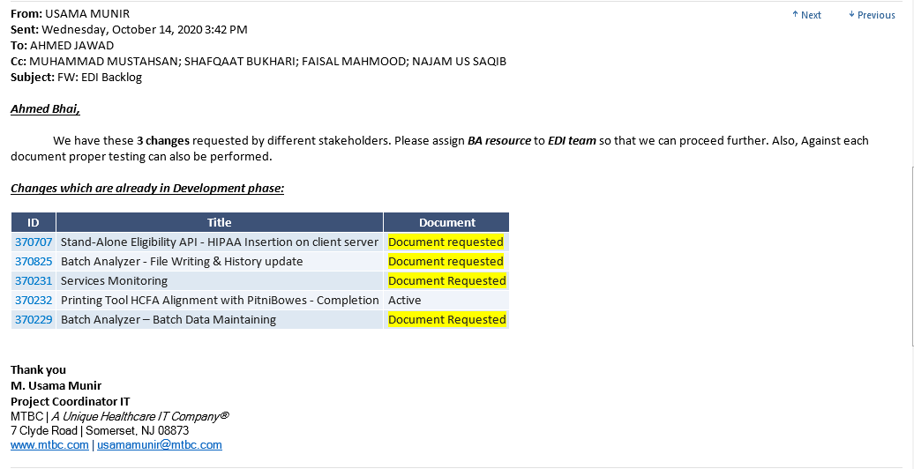
Change Request Details
Requestor Name | Usama Munir
Request Scope | Patient Eligibility
Email Subject | EDI Backlog

Slide 3
Problem Statement (Current System)
New Changes

Slide 4
PROPOSED CHANGES

Slide 5
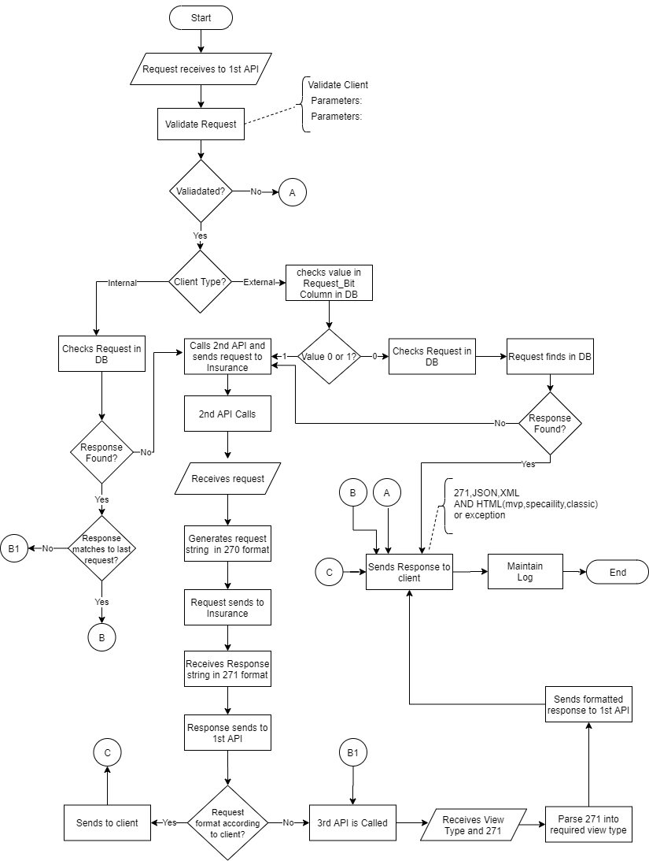
Flowchart:

Slide 6
Whole scenario of Eligibility APIs
We will have 3 APIs
The 1st API will receive request (parameterized) from the client and validate it
Response against that particular request is checked in DB
If fount in DB and the required format is 271 or required format is same as last request, API will response back to requestor.
If the response is not available in DB, API will send the request to 2nd API
The 2nd API will generate request in 270 format and will send it to insurance company or will request in parameterized format to insurance.
The insurance company will respond back to 2nd API in 271 format
The 2nd API will send the response to 1st API
If the required format is 271 then 1st API will response received 271 string to requestor.
Otherwise 271 string will be sent to 3rd API for parsing.
3rd API will response back to 1st API in the required format e.g. JSON, XML, HTML(mvp, specialty, classic) etc.
Log will be maintained in the Eligibility_API_Logs table.

Slide 7
Duplicate Request
In case of duplicate request, the whole process will be repeated again.
The Request will be checked in DB in case of internal client, and in case of external client, if response bit is 0 it will be checked in DB and if response bit is 1 request will be sent to insurance.
API will follow the same process for each request, either it is new or duplicated.

Slide 8
1st API : Requests received from client
The 1st API will receive request from the client
API will validate request on the basis of two items i.e. client and parameter format
Parameter format :
Date format 20201102 'yyyymmdd‘
If there is some issue, API will response back to the client
API will check whether the client is internal or external through Internal_Client from Eligibility_API_Clients table. 1 means MTBC internal client and 0 means external.
Internal clients are those which come through MTBC’s software's e.g. webEHR, TalkEHR etc.
External clients are third parties no using MTBC softwares.
Internal clients will send Payer_ID from ELIGIBILITY_PAYER_INFORMATION table
External client will send S_no from ELIGIBILITY_PAYER_INFORMATION table and while sending request to 2nd API, Payer_ID will be picked using S_no from aforementioned table.

Slide 9
1st API : Requests received from client (Contd.)
The values against the external clients are 0 or 1
The values are stored in “Response_Bit” column in Eligibility_API_Clients table
If the value against a client is 0, API will check the request in DB
If API finds respond to the request in DB, it will send it to client
If the value against a client is 1, 1st API will call 2nd API to send request to Insurance
In case the client is Internal, API will by-default check in DB
If API can’t find the request in DB, it will be sent to 2nd API by 1st API.
This API also maintains a log of Requests and Responses

Slide 10
Use Case 1
Use Case Name: Customer’s data validation
Primary Actor | Client
Stake holders and their interests | Client Interest: Wants to verify a customer’s insurance activeness
Success Condition (If) | EDI service will be consumed. Customer’s data will be validated
Failed Condition (Else) | EDI service will not be consumed. Customer’s data will not be validated

Slide 11
1st API: Parameters Received in-case of Internal client
Parameters will be received from Client
Parameters and sample input for Internal clients are mentioned below:
Mandatory Parameters:
"ClientId" : "10032",
"PayerName" : "CMS",
"PayerId" : "CMS",
"ProviderLastName" : "HEMCARE MEDICAL CLINIC, PC",
"ProviderFirstName" : "",
"ProviderNPI" : "1982639407",
"MemberId" : "5HQ1NY9AK00",
"PatientDOB" : "19191102",
"PatientLastName" : "Thomas",
"PatientFirstName" : "Marie",
"SubscriberLastName" : "",
"SubscriberFirstName" : "",
"SubscriberDOB" : "19191102",
"RelationshipCode" : "S",
"DateOfService" : "20200602",
"ServiceTypeCode" : "30",
"RequestType":"classic",
"Client_Type":"Patient",
"Patient_Account":"6010039534101",
"claim_number":null
“ServerName”
“InsuranceId”
Optional Parameters:
"ProviderTaxId" : null,
"ProviderPin" : null,
"Gender":"F",

Slide 12
1st API: Parameters Received in-case of External client
Parameters and sample input for External clients are mentioned below:
Mandatory Parameters:
"ClientId" : "1104",
"PayerName" : "CMS",
"PayerId" : "0002",
"ProviderLastName" : "HEMCARE MEDICAL CLINIC, PC",
"ProviderFirstName" : "",
"ProviderNPI" : "1982639407",
"MemberId" : "5HQ1NY9AK00",
"PatientDOB" : "19191102",
"PatientLastName" : "Thomas",
"PatientFirstName" : "Marie",
"SubscriberLastName" : "",
"SubscriberFirstName" : "",
"SubscriberDOB" : "19191102",
"RelationshipCode" : "S",
"DateOfService" : "20200602",
"ServiceTypeCode" : "30",
"RequestType":"classic",
"Client_Type":"Patient",
"Optional Parameters:
"ProviderTaxId" : null,
"ProviderPin" : null,
Gender":"F",
InsuranceId

Slide 13
Following parameters will be used for DB searching
PayerName
PayerId
MemberId
PatientDOB
PatientLastName
PatientFirstName
SubscriberLastName
SubscriberFirstName
SubscriberDOB
RelationshipCode
DateOfService
ServiceTypeCode

Slide 14
Eligibility_API_Clients Table
Table Name | Column Name | Parameter Name
Eligibility_API_Clients | Id
 | ClientId
 | Name
 | INTERNAL_CLIENT
 | Response_Bit

Slide 15
Use Case 2
Use Case Name: Maintain Log
Primary Actor | EDI
Stake holders and their interests | Client Interest: Wants to verify a customer’s status
Success Condition (If) | EDI service will be consumed. Log is maintained for the client’s request and its response
Failed Condition (Else) | EDI service will not be consumed. Log will not be maintained

Slide 16
Eligibility_API_Logs Table
Following parameters are required to maintain log
Table Name | Column Name | Parameter Name | Data Type (Length) | Type
Eligibility_API_Logs | ClientID | ClientId | nvarchar (400) | Situational
 | PayerName | PayerName | Nvarchar (200) | Mandatory
 | PayerId | PayerId | nvarchar (200) | Mandatory
 | ProviderLastName | ProviderLastName | nvarchar (200) | Mandatory
 | ProviderFirstName | ProviderFirstName | nvarchar (200) | Situational
 | ProviderNPI | ProviderNPI | nvarchar (200) | Mandatory
 | ProviderTaxId | ProviderTaxId | nvarchar (200) | Optional
 | ProviderPin | ProviderPin | nvarchar (200) | Optional
 | MemberID | MemberId | nvarchar (200) | Mandatory
 | PatientDOB | PatientDOB | Datetime (8) | Mandatory
 | PatientLastName | PatientLastName | nvarchar (200) | Mandatory
 | PatientFirstName | PatientFirstName | nvarchar (200) | Mandatory
 | SubscriberLastName | SubscriberLastName | nvarchar (200) | Situational
 | SubscriberFirstName | SubscriberFirstName | nvarchar (200) | Situational
 | SubscriberDOB | SubscriberDOB | datetime (8) | Situational
 | Relationship | RelationshipCode | nvarchar (200) | Mandatory
 | DateOFService | DateOfService | datetime (8) | Mandatory
 | ServiceTypeCode | ServiceTypeCod | nvarchar (-1) | Mandatory
 | RequestType | RequestType | varchar (50) | Mandatory
 | ClientType | Client_Type | nvarchar (100) | Mandatory
 | Gender | Gender | nvarchar (50) | Optional
In case of Internal client following parameters are added into the above list i.e.
 | Patient_Account | Patient_Account | bigint (8) | Mandatory
 | Claim_No | claim_number | bigint (8) | Mandatory
 | ServerName | ServerName | nvarchar (100) | Mandatory
 | InsuranceID | InsuranceId | nvarchar (200) | Situational
“InsuranceId” is Mandatory incase of Internal clients while it is Optional in case of External clients

Slide 17
Use Case 3
Use Case Name: Sends Request to Insurance Company
Primary Actor | EDI
Stake holders and their interests | EDI Interest: wants to verify customer’s status from insurance company
Success Condition (If) | EDI service will be consumed. API will send request to insurance company for verification
Failed Condition (Else) | EDI service will not be consumed. API will not send request to insurance company

Slide 18
2nd API : Sends request to insurance
Generates request in 270 format or parameterized request
Sends request to Insurance
Receives response from insurance in 271 format
The 2nd API then sends the response of the insurance to 1st API

Slide 19
2nd API : Receives Parameters from 1st API
Parameters from 1st API will be received
Parameters and sample input for Internal clients are given below:
Mandatory Parameters:
"PayerName" : "CMS",
"PayerId" : "CMS",
"ProviderLastName" : "HEMCARE MEDICAL CLINIC, PC",
"ProviderFirstName" : "",
"ProviderNPI" : "1982639407",
"MemberId" : "5HQ1NY9AK00",
"PatientDOB" : "19191102",
"PatientLastName" : "Thomas",
"PatientFirstName" : "Marie",
"SubscriberLastName" : "",
"SubscriberFirstName" : "",
"SubscriberDOB" : "19191102",
"RelationshipCode" : "S",
"DateOfService" : "20200602",
"ServiceTypeCode" : "30"
Optional Parameters:
"Gender":"F",

Slide 20
Below mentioned parameters will be used to generate 270 string
PayerName
PayerId
ProviderLastName
ProviderFirstName
ProviderNPI
MemberId
PatientDOB
PatientLastName
PatientFirstName
SubscriberLastName
SubscriberFirstName
SubscriberDOB
RelationshipCode
DateOfService
ServiceTypeCode

Slide 21
Use Case 4
Use Case Name: Sends Request to Insurance Company
Primary Actor | EDI
Stake holders and their interests | EDI Interest: Wants to verify a customer’s insurance activeness from Insurance company
Success Condition (If) | EDI service will be consumed. API will send request to insurance company for verification
Failed Condition (Else) | EDI service will not be consumed. Request will not be sent to insurance company

Slide 22
Data Send to insurance
Following is 270 Format of a request
ISA*00* *00*
*ZZ*SENDERID *ZZ*CMS
*201014*0713*^*00501*133774371*0*P*|
~GS*HS*SENDERID*CMS*20201014*0713*1*X*005010X279A1~ST*270*1001*
005010X279A1~BHT*0022*13*1001*20201014*0713~HL*1**20*1~NM1*PR*2*CMS
*****PI*CMS~HL*2*1*21*1~NM1*1P*2*DANIEL B WRIGHT DNP LLC
*****XX*1801421714~HL*3*2*22*0~TRN*1*002954*9000000001~NM1*IL*1*KEMP*Carol
****MI*4WX9N34AR49~DMG*D8*19341205~DTP*291*D8*20201014
~EQ*1^2^3^4^5^6^7^8^10^12^13^14^15^18^20^23^24^25^26^27^28^30^33^36^37^38^39^40^41
^42^45^47^48^49^50^51^52^53^54^62^65^67^68^69^73^76^78^80^81^82^83^86^88^93^98^
99^A0^A3^A4^A5^A6^A7^A8^AD^AE^AF^AG^AI^AJ^AK^AL^BF^BG^BH^BT^BU^BV^CQ^DM^MH^
UC^RN~EQ**HC|76706~EQ**HC|76977~EQ**HC|77078~EQ**HC|77080~EQ**HC|77081~EQ**HC|80061~EQ*
*HC|82270~EQ**HC|82465~EQ**HC|82947~EQ**HC|82950~EQ**HC|82951~EQ**HC|83718~EQ**HC|84478~EQ**
HC|90670~EQ**HC|90732~EQ**HC|G0101~EQ**HC|G0102~EQ**HC|G0103~EQ**HC|G0104
~EQ**HC|G0105~EQ**HC|G0106~EQ**HC|G0117~EQ**HC|G0118~EQ**HC|G0120~EQ**HC|G0121~EQ**HC|G0123
~EQ**HC|G0130~EQ**HC|G0143~EQ**HC|G0144~EQ**HC|G0145~EQ**HC|G0147~EQ**HC|G014
8~EQ**HC|G0328~EQ**HC|G0402~EQ**HC|G0403~EQ**HC|G0404~EQ**HC|G0405~EQ**HC|G0438~EQ**HC|G0439
~EQ**HC|G0444~EQ**HC|G0445~EQ**HC|G0446~EQ**HC|G0447~EQ**HC|G0472~EQ**HC|G0473
~EQ**HC|G0475~EQ**HC|G0499~EQ**HC|P3000~EQ**HC|Q0091~SE*62*1001~GE*1*1~IEA*1*133774371~

Slide 23
Data Returned By Insurance
Following is 271 Format of a response
ISA*00* *00*
*ZZ*IVANS-CMS-RT *ZZ*EO-IVANS-RT
*201014*0613*^*00501*401896025*0*P*|~GS*HB*IVANS-CMS-RT*EO-IVANS-RT*20201014*0613
*401896025*X*005010X279A1~ST*271*111896026*005010X279A1~BHT*0022*11*401896025*20201014
*061338~HL*1**20*1~NM1*PR*2*CMS*****PI*CMS~HL*2*1*21*0~NM1*1P*2*DANIEL B WRIGHT DNP LLC
*****XX*1801421714~AAA*N**41*C~SE*8*111896026~GE*1*401896025~IEA*1*401896025~

Slide 24
Use Case 5
Use Case Name: Receives Request from 1st API
Primary Actor | EDI
Stake holders and their interests | EDI Interest: wants to parse the file in specified format
Success Condition (If) | EDI service will be consumed. API will parse the request in requested format
Failed Condition (Else) | EDI service will not be consumed. API will not parse the request

Slide 25
3rd API : Parse the response of the 1st API
1st API will send the 271 response to the 3rd API
Response Type and 271 format will be sent as parameters
The 3rd API will parse the response into the required format i.e. Response type
The parsed response will be sent back to 1st API
Resonse can only be of the following types:
JSON, XML AND HTML(mvp, specialty, classic)

Slide 26
Use Case 7
Use Case Name: Sends Response to Customer
Primary Actor | EDI
Stake holders and their interests | Client Interest: Wants to verify a customer’s insurance activeness
Success Condition (If) | EDI service will be consumed. Response will be sent to client against his request
Failed Condition (Else) | EDI service will not be consumed. Response will not be sent to customer

Slide 27
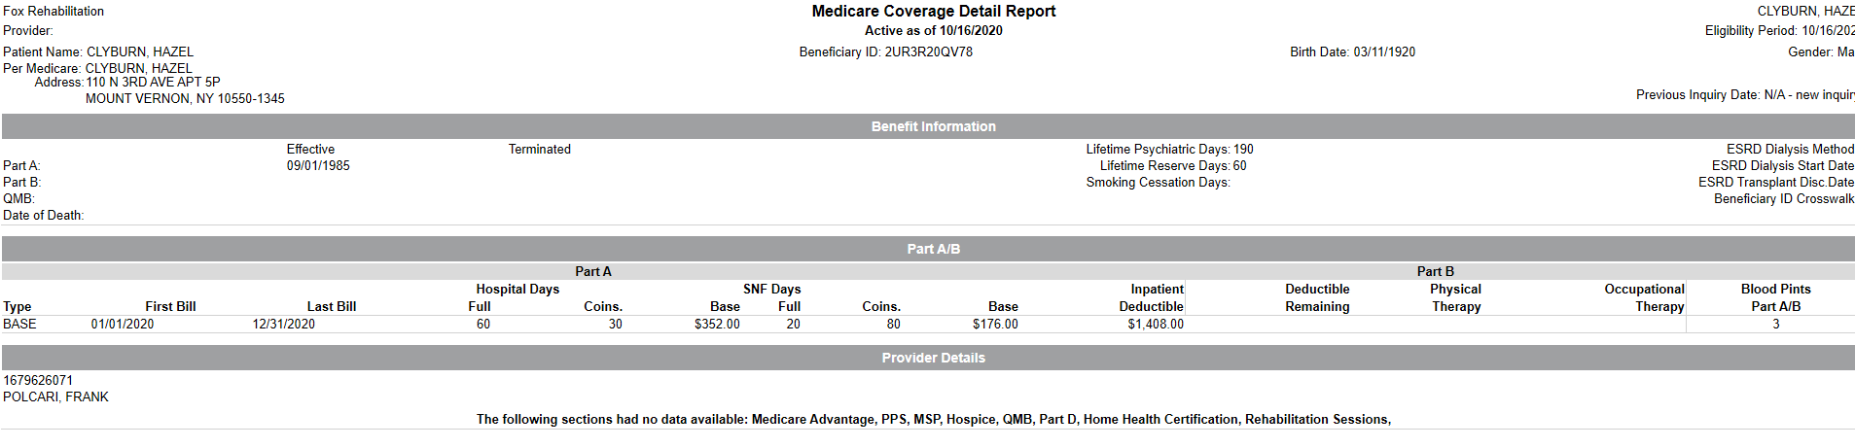
Data Parsed into HTML
Html – mvp format of a response

Slide 28
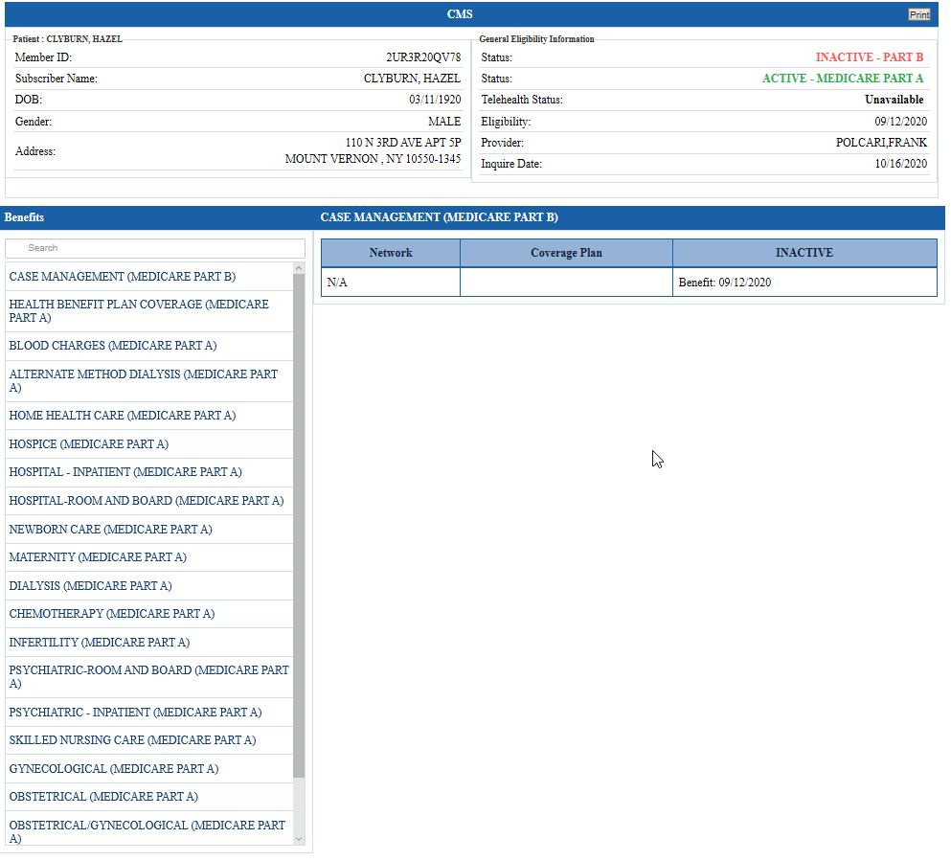
Data Parsed into HTML (Contd.)
Html – classic format of a response

Slide 29
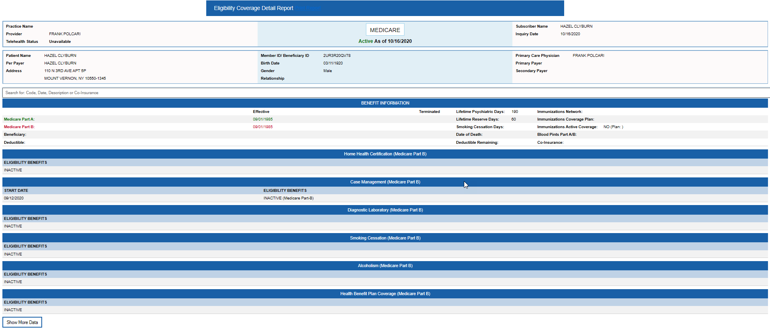
Data Parsed into HTML (Contd.)
Html – specialty format of a response

Slide 30
Eligibility_API_Exceptions Table
Table Name | Column Name | Parameter Name
Eligibility_API_Exceptions | Id
 | Code
 | Description

Slide 31
Status Codes for Responses in case of any Missing Parameter or Error
Code | Response / Description
001 | Sql Injection
002 | Invalid Client Id
003 | Required Params
004 | Internal Server Error
005 | Client Id Is Required
006 | Payer Name is Required
007 | Payer Id is Required
008 | Provider Last Name is Required
009 | Provider NPI Is Required
010 | Member ID Is Required
011 | Patient Date of birth Is Required
012 | Provider First Name Is Required
013 | Patient Last Name Is Required
014 | Subscriber Relationship Code Is Required
015 | Date of service Is Required
016 | Invalid Payer Id
017 | INVALID PARTICIPANT IDENTIFICATION
018 | INVALID REQUEST
019 | Invalid Date (Negative Date)
020 | Invalid Date of service
021 | Invalid Subscriber DOB
022 | Invalid Patient DOB
023 | Invalid Payer Id
024 | Invalid Relationship Code
025 | Patient Account is Required
026 | We Are Not Providing Real Time Eligibility for this Payer
027 | Please Use Correct Request Type

Slide 32
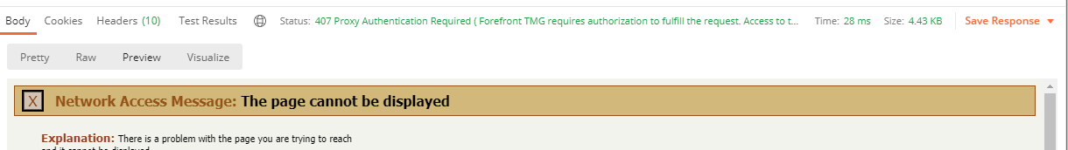
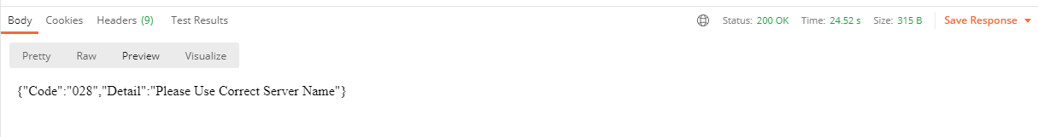
Status Codes for Responses in case of any Missing Parameter or Exception
The standard status code such as 407, 400 etc. will be displayed to client/user in case of concerned issue, but these codes (standard codes) will not be saved in DB. The DB will only store the exception in our format given below in Eligibility_API_Exceptions Table.

Slide 33
Status Codes for Responses in case positive flow
The standard status code for “OK” i.e. 200 is displayed to client/user when the API will receive hits and response back properly.

Slide 34
End Points of the APIs
End Points of the 1st API: http://10.10.30.47:9945/api/eligibility/transactions
The API will be initiated when the client requests to the API
The API Sends the response to client
End Points of the 2nd API: http://10.10.30.47:8045/
The API receives request from 1st API
The API Sends the response to 1st API
End Points of the 3rd API: http://10.10.30.47:8099/
The API receives view type and 271 format from 1st API
The API Sends the response to 1st API
Note:
The links of 2nd and 3rd APIs is confidential i.e. they will not be public but only accessed by 1st API.
The 1st API will only be public.

Slide 35
Objects Received in a Request
The requests contains single object.

Slide 36
Which authentication type will be performed?
Currently the API will be accessed only by internal clients, that’s why there will be no specific authentication process
But still, User ID and Password verification will be there for safe side. But in future, only First API can be made public, then the authentication type
will be decided with the coordination of our Data Security team.

Slide 37
Detailed Field Template
Validations |  |  |  |  |  |  | Validation Message Texts | Database Details
Text Field
Name/Label | Data Type | Default Value | Length | Mandatory | Functionality/ Action | Dependency | N/A | Table Name | Column Name | Type | Length
[Exp: First Name] | N/A | N/A | N/A | N/A | N/A | N/A |  | Eligibility_API_Logs | N/A | N/A | N/A
Checkbox
[Exp: I accept the privacy agreement] | N/A | N/A | N/A | N/A | N/A | N/A | N/A | Eligibility_API_Clients | N/A | N/A | N/A
Radio Button
[Exp: Gender] | N/A | N/A | N/A | N/A | N/A | N/A | N/A | ELIGIBILITY_PAYER_INFORMATION | N/A | N/A | N/A
Drop Down
[Exp: Document List] | N/A | N/A | N/A | N/A | N/A | N/A | N/A | Eligibility_API_Exceptions | N/A | N/A | N/A
Date Picker
[Exp: Date] | N/A | N/A | N/A | N/A | N/A | N/A | N/A | N/A | N/A | N/A | N/A
Link
[Exp: MTBC link] | N/A | N/A | N/A | N/A | N/A | N/A | N/A | N/A | N/A | N/A | N/A
Button
[Exp: Submit] | N/A | N/A | N/A | N/A | N/A | N/A | N/A | N/A | N/A | N/A | N/A

Slide 38
Impact Analysis
Sr. No | Product(s) | Module(s) | Details
1

Slide 39

Thank you

